Slide 1
THE STATE OF ENERGY IN BLACK AMERICA
AABE 2010 ANNUAL CONFERENCE
COLUMBUS, OHIO
MAY 19, 2010

Slide 2
WHAT I COVERED LAST YEAR
African American Families have 73% of the Income but only 1/10 the Wealth of White Families
African American Families pay MORE to Heat and Light Their Homes than any other Ethnic Group
African American Communities are more Polluted than other Communities
African Americans are Concentrated in areas vulnerable to effects of climate change

Slide 3
Rising Energy Costs:
A Cause for Concern in Black America
Price Index of U.S. Consumer Energy Products, 1990-2008
(1990=1.00)
Source: U.S. DOE/EIA Short-Term Energy Outlook (June 2008) and EIA gasoline, residential natural gas and electric historical data since 1990.

Slide 4
Energy Price Increases Hit Low- and Fixed-Income Families Hardest
Families earning $50K or more annually spend just 10% of their income on energy-related expenses
  This income bracket contains less than a third of African-Americans
  53% of White Americans
Families earning $10K or less spend 60% on energy costs
  This income bracket contains over 16% of African-Americans
  Less than 9% of White Americans
For 51% of these households – mostly senior citizens, single parents and minorities – rising energy costs force hard decisions about what other bills to pay… housing, food, education, health care and other necessities
Household Energy Expenditures
vs. After-Tax Income
Over half of Americans shoulder major energy burden
Source: U.S. Bureau of the Census; U.S. Congressional Budget Office (2004); U.S. Dept. of Energy (2008).
Notes:
5

Slide 5
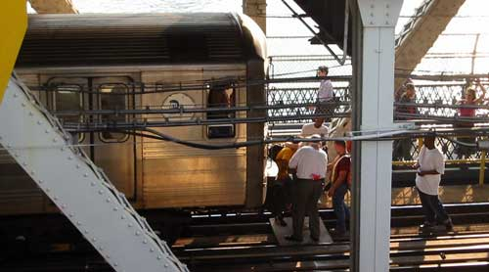
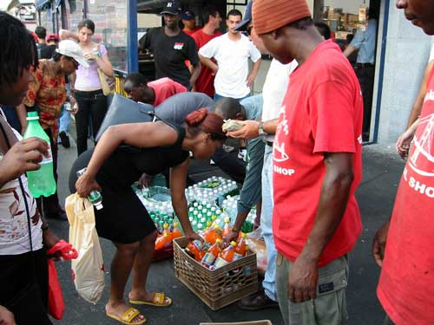
Reliable, AFFORDABLE Electricity is Critical to
Low-Income Households & Small Businesses
The consequences of extended outages are more severe for many minority-based communities, including:
  Lost revenue to small businesses, price increases for local consumers
  Lost wages because of unavailability of public transit for commuting
  Job losses if small businesses are significantly affected
  Increased student absenteeism, higher childcare costs due to disruptions in mass transit
  Increased illness & death from very low or very high temperatures
August 2003: New York City Blackout
Notes:
6

Slide 6
U.N.: Access to Abundant Energy is Key to Quality of Life
Electricity Use Per Capita and the U.N. Human Development Index
1.0
Italy
United
States
Sweden
0.9
Finland
Canada
Argentina
0.8
UAE
Qatar
Brazil
Malaysia
0.7
China
Indonesia
South Africa
Morocco
Human Development Index
0.6
India
0.5
Bangladesh
Zimbabwe
0.4
Zambia
Ethiopia
Mozambique
0.3
0.2
0
5 000
10 000
15 000
20 000
  Electricity Use
Source: International Energy Agency, World Energy Outlook 2005.

Slide 7
LAST YEAR’S CALL TO ACTION
Understand and expand AABE’s Policy Principles
Educate our Communities on Energy and Climate Change
Reach out to Energy Entrepreneurs of Color
Educate Black Policy-makers about Impacts of Energy and Climate Policy
Use the AABE Institute to Develop Energy Expertise at Home and Abroad
Make AABE the Premier Energy Organization in our Community

Slide 8
WHAT’S HAPPENED SINCE THEN?

Slide 9
ECONOMIC STIMULUS PLAN
Most Early Revenues Distributed to States
Complaints from CBC over Lack of Benefit to African American Communities
Administration Discomfort with Business Community Slowed Distribution of Funds
Lingering Unemployment Problems Overwhelmed perceived Program Effectiveness

Slide 10
AABE’S INVOLVEMENT
Meetings with EPA, Dept. of Energy
  Shared Policy Principles
  Introduced African American Entrepreneurs
Meetings with Black Policy Makers
  CBC Legislative Workshop in Tunica, MS
  Presentations to NARUC, NBCSL, NCBM
  CBC Energy Brain Trust Participation
Briefings for Key CBC Members
  Majority Whip Clyburn
  Cong. Butterfield
  Cong. Rush

Slide 11
STRATEGIC PARTNERSHIPS
Memorandum of Cooperation with the National Urban League
Participation on Commission to Engage African Americans on Climate Change
Morehouse College Entrepreneurship Center
Seat on National Petroleum and National Coal Councils

Slide 12
CLIMATE CHANGE/GAME CHANGE
Climate Change has Disproportionate Impact on Communities of Color
  Low-lying Coastal Areas
  Susceptibility to Extreme Heat and Cold
  Higher Incidence of Asthma & Other Respiratory Diseases
Many Climate Change Solutions will impose Disproportionate Costs on Communities of Color
  Cap/Trade
  Renewable Energy

Slide 13
AABE’s involvement
Climate Change Principles Shared with Key Congressional Members, Staff
Op Ed Pieces calling for Climate Equity
Community Energy Forums
White Paper for Commission to Engage African Americans on Climate Change Delegation to COP15 in Copenhagen
Energy/Climate Change Summit

Slide 14
COP15 – an eye-opener
Climate Change Pits Haves against Have-nots
Copenhagen “Accord” was only among Developed Nations (including BRIC countries)
Global South – largely island and developing economies – Unanimously Oppose Copenhagen Accord
  Want Tighter Cap, Sooner

Slide 15
Questions from Copenhagen
What does Global South Position mean for the US?
What does It mean for African Americans?
How should AABE Engage on this Issue?

Slide 16
Energy/climate summit
Held January 27, 2010
Brought Diverse African American, Hispanic and Other Community Interests together
Showcased Expert Resources - academics, think tanks, trade organizations
Agreed on a Set of Common Principles
  Cost Mitigation for low-income consumers
  Fair allocation of cost burden
  Energy Jobs, Entrepreneur Opportunities for Communities of Color
  Energy/Climate Literacy

Slide 17
Energy/climate coalition
Outgrowth of Summit
Continues Dialogue among Participant Groups
Guiding Principles form Basis for Coalition Participation
Each Organization Argues Issues from Its Perspective
Coalition will Seek Independent Funding

Slide 18
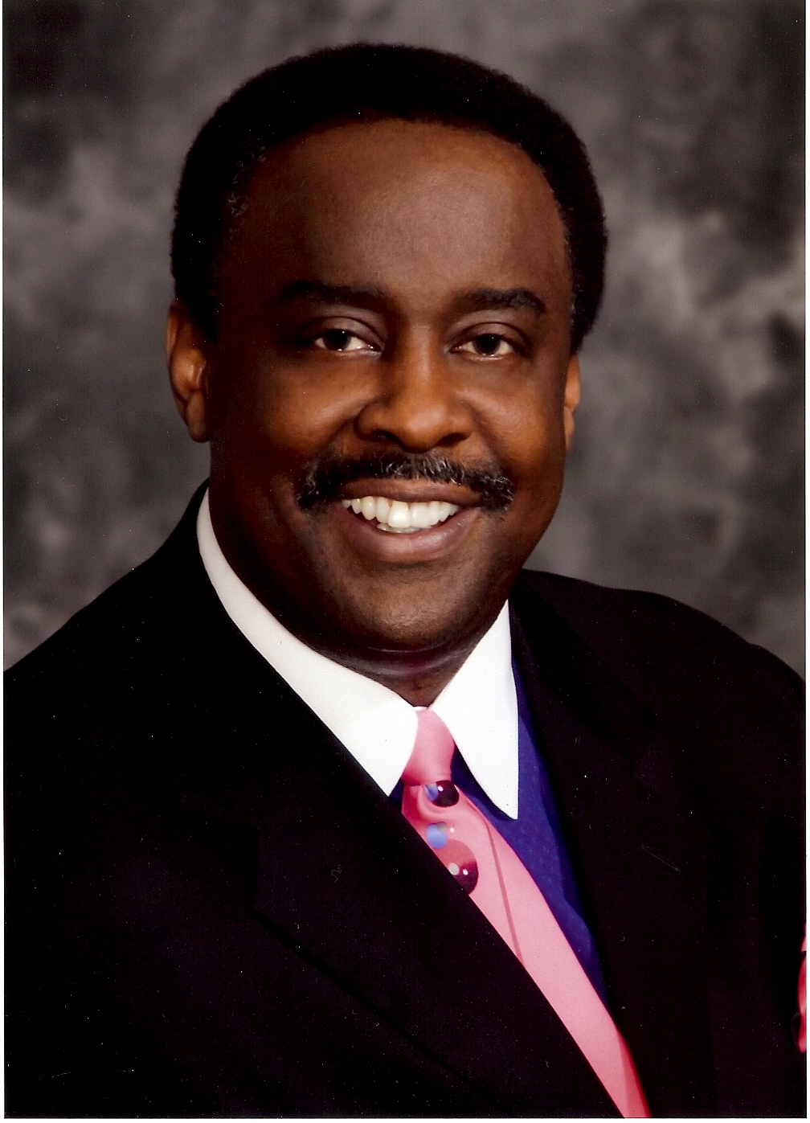
Energy entrepreneurs
First Entrepreneur of the Year Award Recipient – Steve Hightower, CEO Hightowers Petroleum

Slide 19
Energy entrepreneurs
AABE Entrepreneur Website goes live – August 2009
Several Chapters hold Entrepreneur Forums
AABE Partners with Morehouse College on Entrepreneur Symposium
AABE helps plan DOE 2010 Small Business Conference
AABE Teams with US Dept. of Commerce and MBDA to Identify Minority Entrepreneurs

Slide 20
The bottom line
Energy and Climate Change are Here to Stay
African Americans have Critical Role to Play
Coalition Building is the Name of the Game
Economic and Energy situation present Opportunities as well as Challenges
AABE Entrepreneurs are Stepping Up to the Plate

Slide 21
It’s our time!

